Slide 1
UNIT 6
File System
CO 6:Describe file systems concepts.

Slide 2
6.0 INTRODUCTION
In a computer system the main memory is used by many applications to store and retrieve data and information.
When a process is running, it can store a limited amount of information within its own address space.
But the storage capacity is restricted to the size of virtual address space.
There are 3 essential requirements for long term information storage:
It must be possible to store a very large amount of information
The information must survive the termination of the process using it
Multiple processes must be able to access the information concurrently
Different types of storage devices like magnetic disks and tapes were used for storing large amount of information.
The file system provides the mechanism for online storage of and access to both data and programs residing on the disks.

Slide 3
A file is a collection of related information defined by its creator.
The file are mapped by the OS onto physical devices.
Files are normally organized into directories for ease of use.
The file system consists of two distinct parts- a collection of files, each storing related data, and a directory structure, which organizes and provides information about all the files in the system.
6.1 File Concept
Information can be stored by computers on various storage media such as magnetic disks, magnetic tapes and optical disks.
OS provides a uniform logical view of information storage.
The OS abstracts from the physical properties of its storage devices to define a logical storage unit-file.
A file is a named collection of related information i,e recorded on secondary storage.

Slide 4
From a user’s perspective a file is the smallest allotment of logical secondary storage i,e data cannot be written to secondary unless they are within a file.
Files represent programs both source and object forms and data.
Data files may be numeric, alphabetic, alphanumeric or binary.
Files may be free form such as text files or can be formatted rigidly.
A file has a certain defined structure, which depends on its size
A text file is a sequence of characters organized into lines and pages
A source file is a sequence of subroutines and functions each of which is further organized as declarations followed by executable statements
An object file is a sequence of bytes organized into blocks understandable by the system’s linker.
An executable file is a series of code sections that the loader can bring into memory and execute.

Slide 5
6.1.1 File Attributes
Name – only information kept in human-readable form
Identifier – unique tag (number) identifies file within file system
Type – needed for systems that support different types
Location – pointer to file location on device
Size – current file size
Protection – controls who can do reading, writing, executing
Time, date, and user identification – data for protection, security, and usage monitoring
Information about files are kept in the directory structure, which is maintained on the disk

Slide 6
6.1.2 File Operations
File is an abstract data type. To define a file properly, there is a need to consider the operations that can be performed on files.
Creating a file
Writing a file
Reading a file
Reposition within file
Deleting a file
Truncating a file

Slide 7
Open Files
Several pieces of data are needed to manage open files:
  File pointer: pointer to last read/write location, per process that has the file open
  File-open count: counter of number of times a file is open – to allow removal of data from open-file table when last processes closes it
  Disk location of the file: cache of data access information
  Access rights: per-process access mode information
  Open File Locking
Provided by some operating systems and file systems
Mediates access to a file
Mandatory or advisory:
  Mandatory – access is denied depending on locks held and requested
  Advisory – processes can find status of locks and decide what to do

Slide 8
6.1.3 File Types
A File system or an OS must be able to recognize and support file types so that they can operate on the file in reasonable ways.
A common technique for implementing file types is to include the type as part of the file name.
The file name is split into 2 parts: a name and an extension separated by a period character.

Slide 9


Slide 10
6.2 Access Methods
Files store information.
When it is used, this information must be accessed and read into computer memory.
The information in the file can be accessed in several ways, viz:
Sequential Access
Direct or Random Access
6.2.1 Sequential Access
Information in the file is processed in order, one record after the other.
A read operation: read next- reads the next portion of the file and automatically advances a file pointer, which tracks the I/O location
The write operation: write next – appends to the end of the file and advances to the end of the newly written material the new end of file.

Slide 11

Such a file can be reset to the beginning and on some systems, a program may be able to skip forward or backward ’n’ records for some integer ‘n’ i,e only for n=1.
Fig: Sequential Access file

Slide 12
6.2.2 Direct Access
A file is made up of fixed length logical records rapidly in no particular order.
The direct access method is based on a disk model of a file, since disks allow random access to any file block.
For direct access, the file is viewed as a numbered sequence of blocks or records
There are no restrictions on the order of reading or writing for a direct access file.
Direct access files are of great use for immediate access to large amounts of information.

Slide 13

6.2.3 Other Access Methods
Access Methods can be built on top of a direct access method
These methods generally involve the construction of an index for the file.
The index like an index in the back of a book contains pointers to the various blocks
To find a record in the file first the index is searched and then use the pointer to access the file directly and to find the desired record.
Example of Index and Relative Files

Slide 14
6.3 Directory And Disk Structure
A collection of nodes containing information about all files
Directory
Files
F 1
F 2
F 3
F 4
F n
Both the directory structure and the files reside on disk
Backups of these two structures are kept on tapes

Slide 15
Disk Structure
Disk can be subdivided into partitions
Disks or partitions can be RAID protected against failure
Disk or partition can be used raw – without a file system, or formatted with a file system
Partitions also known as minidisks, slices
Entity containing file system known as a volume
Each volume containing file system also tracks that file system’s info in device directory or volume table of contents
As well as general-purpose file systems there are many special-purpose file systems, frequently all within the same operating system or computer

Slide 16
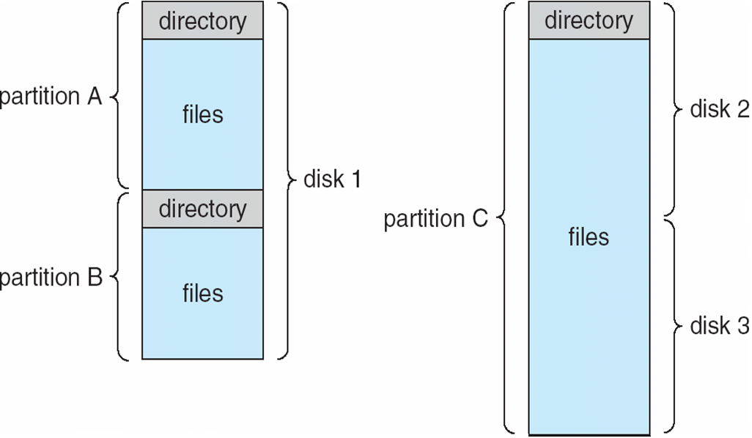
A Typical File-system Organization

Slide 17
Different Directory Structure
Single level directory structure
Two level directory structure
Tree Structured directory structure
Acyclic Graph directory structure
General Graph directory structure
Operations Performed on Directory
Search for a file
Create a file
Delete a file
List a directory
Rename a file
Traverse the file system

Slide 18
Organize the Directory (Logically) to Obtain
Efficiency – locating a file quickly
Naming – convenient to users
  Two users can have same name for different files
  The same file can have several different names
Grouping – logical grouping of files by properties, (e.g., all Java programs, all games, …)

Slide 19

Single-Level Directory
A single directory for all users
Naming problem
Grouping problem

Slide 20

Two-Level Directory
Separate directory for each user
Path name
Can have the same file name for different user
Efficient searching
No grouping capability

Slide 21

Tree-Structured Directories

Slide 22
Efficient searching
Grouping Capability
Current directory (working directory)
  cd /spell/mail/prog
  type list
Absolute or relative path name
Creating a new file is done in current directory
Delete a file rm <file-name>
Creating a new subdirectory is done in current directory
  mkdir <dir-name>
Example: if in current directory /mail
mkdir count
mail
prog
copy
prt
exp
count
Deleting “mail” ⇒ deleting the entire subtree rooted by “mail”

Slide 23

Acyclic-Graph Directories
Have shared subdirectories and files

Slide 24
Two different names (aliasing)
If dict deletes list ⇒ dangling pointer
Solutions:
  Backpointers, so we can delete all pointers
  Variable size records a problem
  Backpointers using a daisy chain organization
  Entry-hold-count solution
New directory entry type
  Link – another name (pointer) to an existing file
  Resolve the link – follow pointer to locate the file

Slide 25
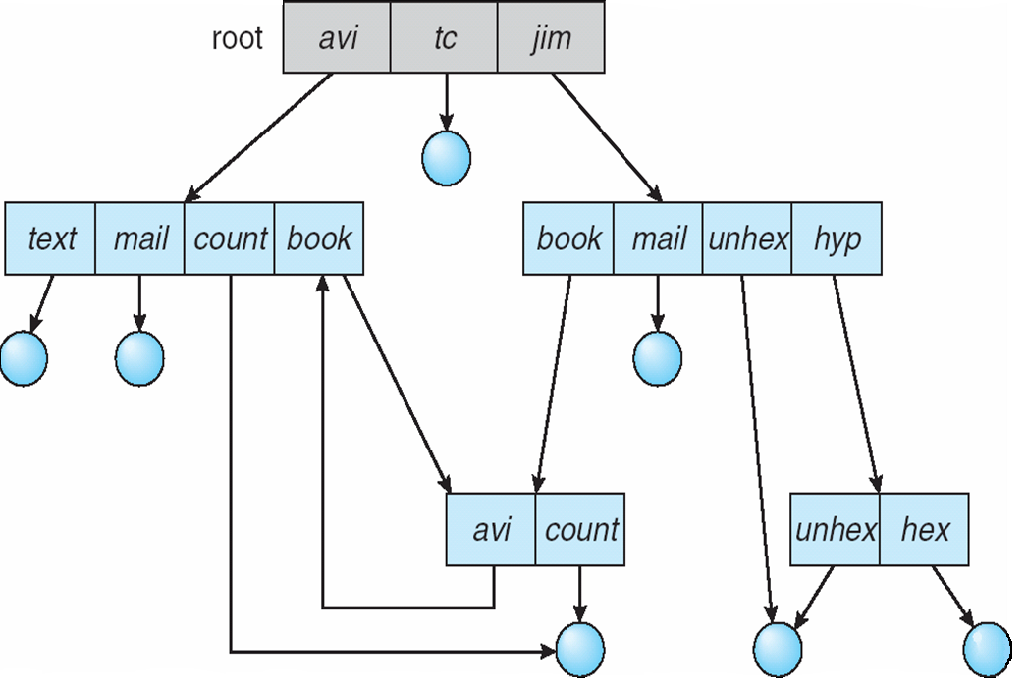
General Graph Directory

Slide 26
File Sharing
Sharing of files on multi-user systems is desirable
Sharing may be done through a protection scheme
On distributed systems, files may be shared across a network
Network File System (NFS) is a common distributed file-sharing method
File Sharing – Multiple Users
User IDs identify users, allowing permissions and protections to be per-user
Group IDs allow users to be in groups, permitting group access rights

Slide 27
File Sharing – Remote File Systems
Uses networking to allow file system access between systems
  Manually via programs like FTP
  Automatically, seamlessly using distributed file systems
  Semi automatically via the world wide web
Client-server model allows clients to mount remote file systems from servers
  Server can serve multiple clients
  Client and user-on-client identification is insecure or complicated
  NFS is standard UNIX client-server file sharing protocol
  CIFS is standard Windows protocol
  Standard operating system file calls are translated into remote calls
Distributed Information Systems (distributed naming services) such as LDAP, DNS, NIS, Active Directory implement unified access to information needed for remote computing

Slide 28
File Sharing – Failure Modes
Remote file systems add new failure modes, due to network failure, server failure
Recovery from failure can involve state information about status of each remote request
Stateless protocols such as NFS include all information in each request, allowing easy recovery but less security
File Sharing – Consistency Semantics
Consistency semantics specify how multiple users are to access a shared file simultaneously
  Similar to Ch 7 process synchronization algorithms
    Tend to be less complex due to disk I/O and network latency (for remote file systems
  Andrew File System (AFS) implemented complex remote file sharing semantics

Slide 29
  Unix file system (UFS) implements:
    Writes to an open file visible immediately to other users of the same open file
    Sharing file pointer to allow multiple users to read and write concurrently
  AFS has session semantics
    Writes only visible to sessions starting after the file is closed

Slide 30
Protection
File owner/creator should be able to control:
  what can be done
  by whom
Types of access
  Read
  Write
  Execute
  Append
  Delete
  List

Slide 31
Access Lists and Groups
Mode of access: read, write, execute
Three classes of users
RWX
a) owner access 7 ⇒ 1 1 1
RWX
b) group access 6 ⇒ 1 1 0
RWX
c) public access 1 ⇒ 0 0 1
Ask manager to create a group (unique name), say G, and add some users to the group.
For a particular file (say game) or subdirectory, define an appropriate access.
owner
group
public
chmod
761
game
Attach a group to a file
chgrp G game

